Slide 1
CODE DEPLOY AND CODE PIPELINE PROJECT
Balashundaram A

Slide 2
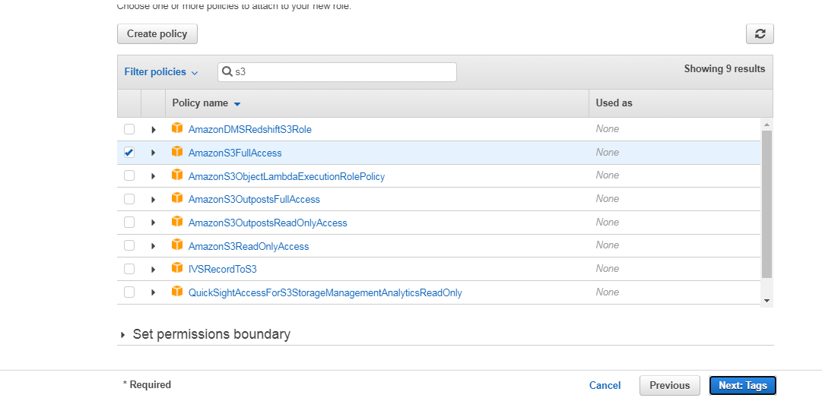
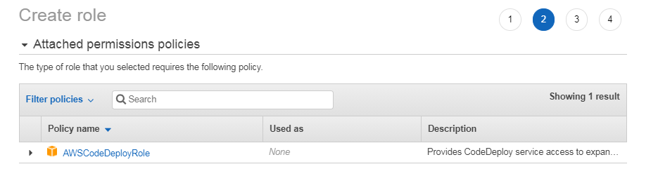
OBJECTIVE:
Complete CI/CD with AWS CodeCommit, AWS CodeBuild, AWS CodeDeploy, and AWS CodePipeline
Step 1: IAM Roles for EC2-S3-CodeDeploy access
a) S3 full access
b) Code-Deploy role

Slide 3
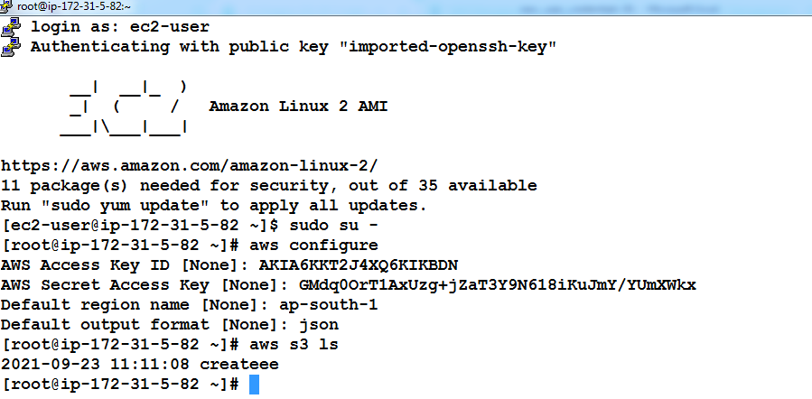
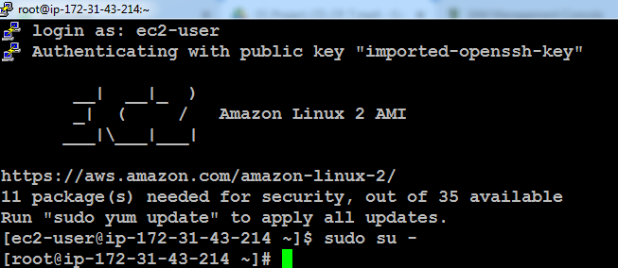
Step 2: Server Deployment
1) Creating an IAM user with full Administrative access and login.
2) Creating an Amazon Linux EC2 server 1 for the developer to create and change the codes.
3) Creating another Linux server 2 for Code Deploy operations.

Slide 4

In the Server 2, the following commands are executed to install CodeDeploy
yum install ruby -y
-> to install ruby
yum install wget -y
-> to install the webget package
wget https://aws-codedeploy-us-east-1.s3.amazonaws.com/latest/install
-> webget command is used to download the files directly from the web.
chmod +x install
-> changing permissions
./install auto
service codedeploy-agent status

Slide 5
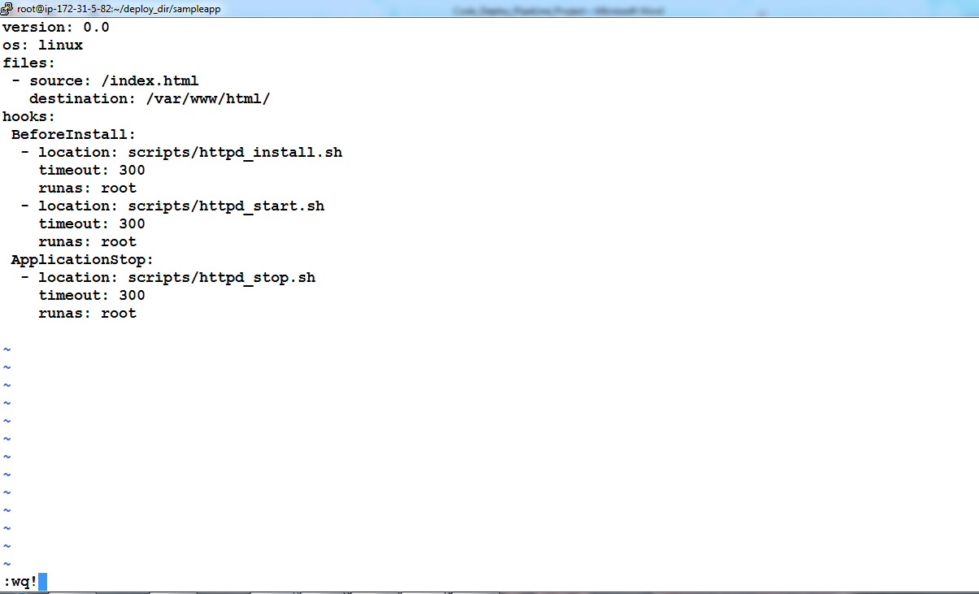
Step 3: Creating the files required for the webpage from Developer machine
Index file - vi index.html
Yaml file - vi abc.yml
This file helps to deploy the source code into webserver automatically.
Creating httpd install , start and stop files which is getting called in yaml file.
vi httpd_install.sh vi httpd_start.sh vi httpd_stop.sh
#!/bin/bash #!/bin/bash #!/bin/bash
yum install -y httpd systemctl start httpd systemctl stop httpd
systemctl enable httpd systemctl disable httpd

Slide 6
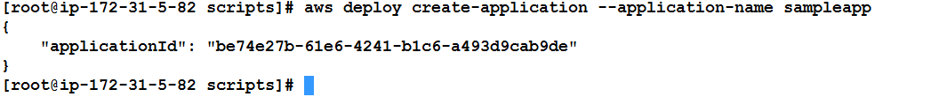
Step 4: Creating Codedeploy Application and Pushing the code to S3 bucket from Server 1
a) Creating a Bucket with Public policy and Bucket Versioning as Enabled.
b) Creating an application in the code deploy using CLI,
aws deploy create-application --application-name sampleapp
c) Uploading the code to S3 by executing the command below,
aws deploy push --application-name sampleapp --s3-location s3://bucname/sampleapp.zip
d) Now in the s3 bucket sampleapp.zip is present.
Step 5: Creating a Deployment Group to include Server 2 using AWS Management Console.
Step 6: Creating a Deployment which pushes code to the Server 2.
Step 7: Creating a Pipeline enabling automatic deployment the moment when the new version reaches the S3 repository.

Slide 7
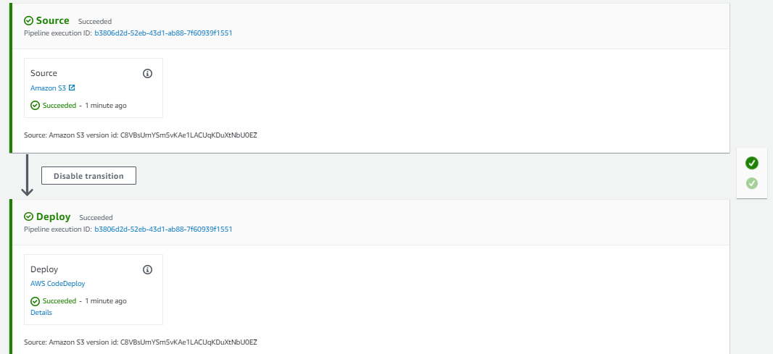
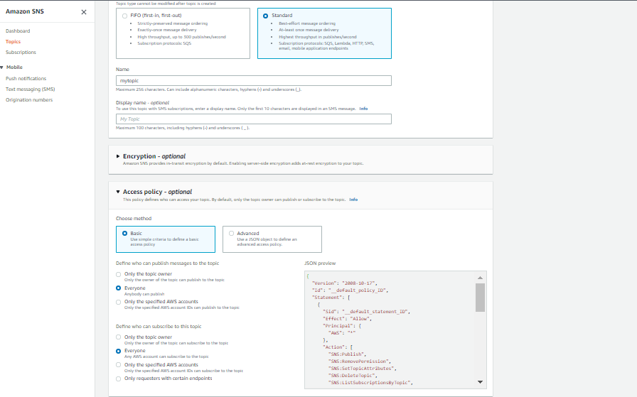
And DONE! Now whenever the Developer changes the code and pushes it to S3 repository the Pipeline recognizes it and triggers services like Code Commit and Code Deploy resulting in changes in the webpage.
Enabling the SNS Notification service to alert us for the deployment success, fail, start, stop etc.

